Slide 1
Outlines
Animation
Move a point horizontally, vertically, linearly, with and without trace.
Animate Circular motion
Animate functions (sin)
Animation using comet
Application with Animation
1- Freefell application
2- Dynamic swing of a mass from a gantry

Slide 2
Animation
Animation is a series of still images that give appearance of motion.
Fundamental structure:
set parameters
calculate motion (and other information)
animate
for it=1:Nt
plot… (optional: line, text, patch, image…)
axis([xmin xmax ymin ymax])
label axes
drawnow
end

Slide 3
SimpleAnimation.m
% SimpleAnimation.m
% move a particle represented ny a circle symbol
% to illustrate the basics of animation
%% set parameters
Nt = 100; % Number of time steps
xmin = 0.1;
xmax = 0.9;
yval = 0.3;
%% create vector
x = linspace(xmin,xmax,Nt);
%% animate position
for it = 1:Nt
plot(x(it),yval,'ro','MarkerSize',8,'MarkerFaceColor','r')
axis([0 1 0 1]), grid on
xlabel('x')
ylabel('y')
title('Motion of a Point')
drawnow
end

Slide 4
Move a point in ‘horizontal’ motion:
plot(x(it),yval,'ro','MarkerSize',8,'MarkerFaceColor','r')
Move a point in ‘Vertical’ motion:
plot(xval, y(it),'ro','MarkerSize',8,'MarkerFaceColor','r')
Move a point in ‘Linear’ motion:
plot(x(it), y(it),'ro','MarkerSize',8,'MarkerFaceColor','r')
Move a point in linear motion and draw a trace
plot(x(1:it), y(1:it),'ro','MarkerSize',8,'MarkerFaceColor','r')

Slide 5
AnimateCircularMotion.m
% AnimateCircularMotion.m
% move a particle in a circle
%% set parameters
Nt=100; % Number of time steps
R=1; % radius of circle
T=1; % period of motion (assume time goes from 0 to 1)
dt=0.03; % time step in seconds--change to vary speed
tmin = 0;
tmax = 2*pi;
%% initialize arrays
t=linspace(tmin,tmax,Nt);
x=R*cos(2*pi*t/T);
y=R*sin(2*pi*t/T);
%% animate circular motion with trailing line
for it=1:Nt
plot(x(1:it),y(1:it),'r',... % plots curve
x(it), y(it),'ro'); % plots point
axis(1.2*[-1 1 -1 1]);
axis square
pause(dt)
drawnow
end

Slide 6
Draw animated sin(x-a)
clear all
close all
x=linspace(0,4*pi,100);
for a= linspace(0,8*pi,100)
plot(x,sin(x-a));
xlim([min(x),max(x)])
drawnow;
pause(1/20);
end

Slide 7
Animation using comet
comet(y) displays a comet graph of the vector y. A comet graph is an animated graph in which a circle (the comet head) traces the data points on the screen. The comet body is a trailing segment that follows the head. The tail is a solid line that traces the entire function.
x=linspace(0,10,1000)
for k=2:length(x)
y1=sin(x);y2=cos(x);
%plot(x,y1,x,y2)
comet(x,y1);comet(x,y2);
end
t = 0:.01:2*pi; x = cos(2*t).*(cos(t).^2); y = sin(2*t).*(sin(t).^2);
comet (x,y);

Slide 8
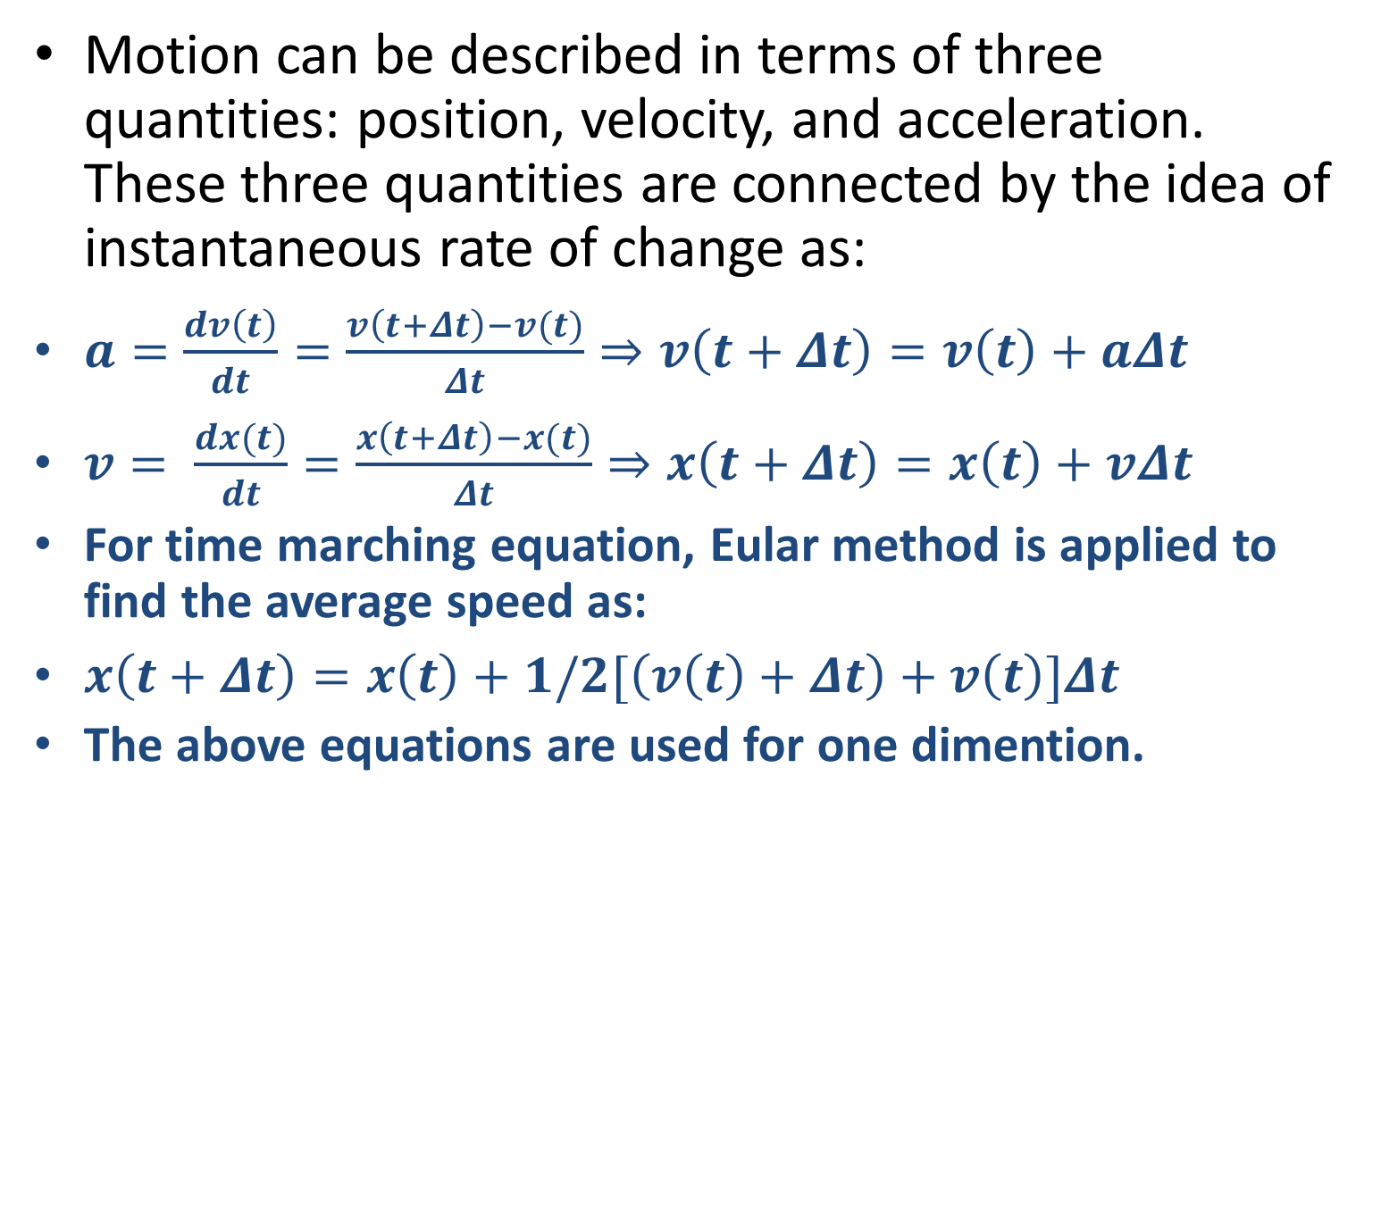
Kinematic motion
Motion can be described in terms of three quantities: position, velocity, and acceleration. These three quantities are connected by the idea of instantaneous rate of change as:
$a=\frac{dv\left(t\right)}{dt}=\frac{v\left(t+Δt\right)−v(t)}{Δt}⇒v\left(t+Δt\right)=v\left(t\right)+aΔt$
$v= \frac{dx(t)}{dt}=\frac{x\left(t+Δt\right)−x(t)}{Δt}⇒x\left(t+Δt\right)=x\left(t\right)+vΔt$
For time marching equation, Eular method is applied to find the average speed as:
$x\left(t+Δt\right)=x\left(t\right)+1/2[\left(v\left(t\right)+Δt\right)+v\left(t\right)]Δt$
The above equations are used for one dimention.

Slide 9
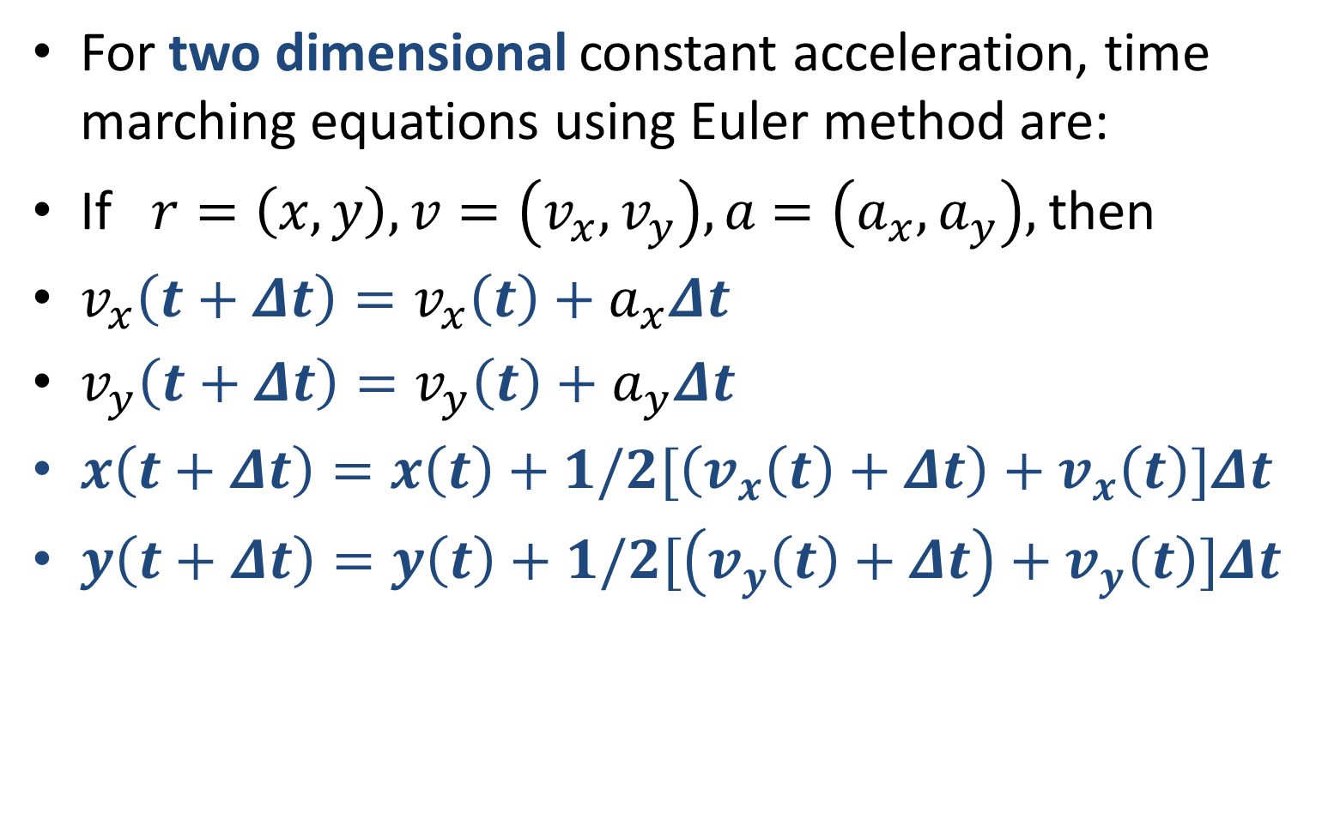
For two dimensional constant acceleration, time marching equations using Euler method are:
If $r=\left(x,y\right), v=\left(v_{x}, v_{y}\right), a$ $=\left(a_{x}, a_{y}\right),$then
$v_{x}\left(t+Δt\right)=v_{x}\left(t\right)+a_{x}Δt$
$v_{y}\left(t+Δt\right)=v_{y}\left(t\right)+a_{y}Δt$
$x\left(t+Δt\right)=x\left(t\right)+1/2[\left(v_{x}\left(t\right)+Δt\right)+v_{x}\left(t\right)]Δt$
$y\left(t+Δt\right)=y\left(t\right)+1/2[\left(v_{y}\left(t\right)+Δt\right)+v_{y}\left(t\right)]Δt$

Slide 10
Animate 1 Dim Constant Velocity
clc; clear ;close
v0=0.1; x0=0;
Tf=10;
deltat=0.05;
%initialization
t=[0:deltat:Tf];
Nt=length(t);
x=zeros(1,Nt); v=zeros(1,Nt);
x(1)=x0; v(1)=v0;
% calculate the motion equation
for it=2:Nt
v(it)=v(it-1);
x(it)=x(it-1)+v(it)*deltat;
end
% plot motion
xmax=max(x);
xmin=min(x);
for it=1:Nt
plot(x(it),0,'bo');
axis([xmin xmax -1 1]);
xlabel('x(m)');ylabel('y(m)');
pause(.01)
drawnow
end

Slide 11
Animate 1 Dim Constant Velocity with bounces
clc; clear ;close
v0=0.1; x0=0;
Tf=10;
deltat=0.01;L=0.1;
%initialization
t=[0:deltat:Tf];
Nt=length(t);
x=zeros(1,Nt); v=zeros(1,Nt);
x(1)=x0; v(1)=v0;
% calculate the motion equation
for it=2:Nt
v(it)=v(it-1);
x(it)=x(it-1)+v(it)*deltat;
% bounce condition
if x(it)>L
v(it)=-abs(v(it)) % flip to the left moving
elseif x(it<0)
v(it)=abs(v(it)) % flip to the right moving
end
end
% plot motion
xmax=max(x);
xmin=min(x);
for it=1:Nt
plot(x(it),0,'bo');
axis([xmin xmax -1 1]);
xlabel('x(m)');ylabel('y(m)');
drawnow
end

Slide 12
Animate 2 Dim Constant acceleration
lc; clear ;close
g=9.81;ax=0;ay=-g;
x0=0;y0=0;
vx0=0;vy0=10;
Tf=5; Nt=1000;
deltat=0.01;
%%initialization
t=linspace(0,Tf,Nt);
x=zeros(1,Nt);
y=zeros(1,Nt); v
x=zeros(1,Nt);
vy=zeros(1,Nt);
x(1)=x0; y(1)=y0;
vx(1)=vx0; vy(1)=vy0;
% calculate the motion equation
for it=1:Nt-1
vx(it+1)=vx(it)+ax*deltat;
vy(it+1)=vy(it)+ay*deltat;
x(it+1)=x(it)+0.5*(vx(it+1)+vx(it))*deltat;
y(it+1)=y(it)+0.5*(vy(it+1)+vy(it))*deltat;
if y(it+1)<0
vy(it+1)=abs(vy(it+1));
end
end
% plot motion
xmax=max(x);
xmin=min(x);
ymax=max(y);
ymin=min(y);
axis([xmin 1 ymin ymax]);
for it=1:Nt
plot(x(it),y(it),'bo',...
x(1:it),y(1:it),'r');
xlabel('x(m)');ylabel('y(m)');
pause(.01)
drawnow
end

Slide 13
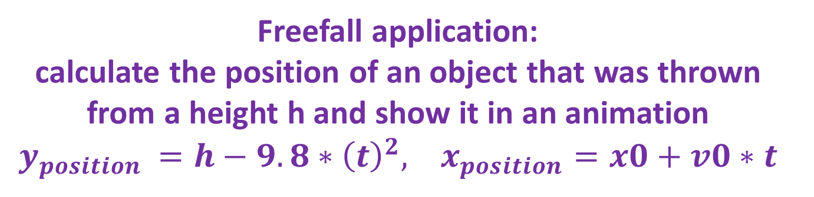
Freefall application: calculate the position of an object that was thrown from a height h and show it in an animation $y_{position }=h−9.8∗{\left(t\right)}^{2}, x_{position}=x0+v0∗t$
function freefall(h,tf,x0,v0)
%freefall will calculate the position of an object that was thrown from a
%height h and show it in an animation
t=0:0.01:tf
for ii=1:1:length(t)
% find y= at^2
% find x
% plot x,y
y(ii)= h-9.8*(t(ii))^2;
x(ii)=x0+ v0*t(ii);
plot(x(ii),y(ii),'*b');
hold on;
drawnow
>> freefall(100,2,0,20)

Slide 14
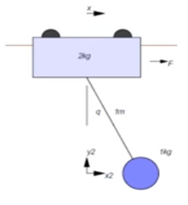
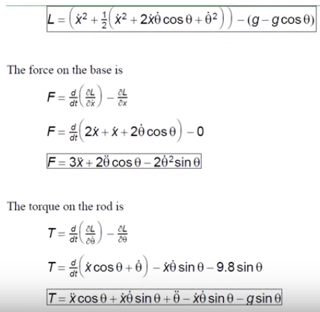
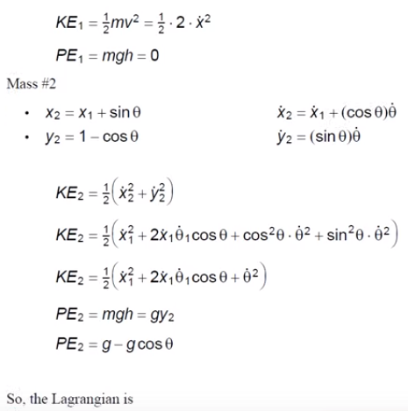
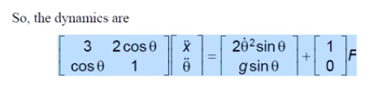
Find the dynamic for the following system. A I Kg mass swings from a gantry which weight 2 Kg. The length of the rope is 1. The energy equations are derived as:

Slide 15
RunCart.m
% RunCart.m
% find the dynamics of 1 Kg swings from a gantry which weight 2 Kg.
% the progarm call CartDynamics(X) and return dX
% X= [ x; q;dx; dq] where x=[position,angle, velocity, angular velocity]
% dX=[dx;dq;ddx], Where dx is the following array
% dX =[ velocity, angular velocity, acceleration, angular acceleratio]
% % Initially X=[0; 0; 0.5; 0]
% dt is the time step
clear
clc
close all
dt =0.01;
X=[0;0.5;0;0];
for i=1:1000
dX=CartDynamics(X);
X=CartI(X,dX,dt);
CartDisplay(X);
end

Slide 16
CartDynamics(X)
CartDisplay(X)
function [dX] = CartDynamics(X)
% [dx]=CartDynamics
%x(1)=x
%x(2)= q;
%x(3)=dx;
%x=(4)=dq
x=X(1)
q=X(2);
dx=X(3);
dq= X(4);
m =[3,2*cos(q);cos(q),1]
b=[2*dq*dq*sin(q);-9.8*sin(q)]
ddx=inv(m)*b
dX=[dx;dq;ddx]
end
function CartDisplay(X)
%Display x=X(1) and q=X(2);
x=X(1);q=X(2);
hold off
plot([-2 2],[2 -2],'.')
hold on
plot([-2 2],[0 0],'-')
% Draw the box
x1=x; y1=0;
plot([x1-0.2, x1+0.2,x1+0.2,x1-0.2,x1-0.2], [0,0,0.1,0.1,0],'-');
%Draw Pendulum
x2=x1+sin(q);y2=y1-cos(q);
plot([x1,x2],[y1,y2],'r-');
plot([x2-0.05,x2+.05,x2+.05,x2-.05,x2-.05],[y2-0.05,y2-0.05,y2+0.05,y2+0.05,y2-0.05],'-');
pause(0.01);
end
CartI(X,dx,dt)
function [X] = CartI(X,dX,dt)
X=X+(dX*dt)
end

